Slide 1
WORKSHOP TECHNOLOGY

Slide 2
SMITHING AND FORGING
SMITHING: Blacksmiths work by heating pieces of wrought iron or steel until the metal becomes soft enough for shaping with hand tools, such as a hammer, an anvil and a chisel. Heating generally takes place in a forge fueled by propane, natural gas, coal, charcoal, coke, or oil.
Some modern blacksmiths may also employ an oxyacetylene or similar blowtorch for more localized heating. Induction heating methods are gaining popularity among modern blacksmiths.

Slide 3
FORGING
Hand forging: - The forging is done by hammering the piece of metal, when it is heated to the proper temperature, on an anvil. While hammering, the heated metal is generally held with suitable tongs. Formers are held on the forging by the smith while the other end is struck with a sledge by a helper. The surfaces of former have different shapes, and they are used to impart these shapes to the forgings. One type of former, called a fuller, having a well-rounded chisel-shaped edge is used to draw out the work.

Slide 4
Hand forging is employed only to shape a small number of light forgings chiefly in repair shops. Hand forging has, of recent years, been superseded by power forging.
Power forging: Large machine part cannot be forged by hand, since the comparatively light blow of a hand-or sledge-hammer is unable to produce a great degree of deformation in the metal being forged. Moreover, hand forging is a lengthy process and requires repeated heating of the metal. This has led to the use of power hammers and presses in forging. Machines which work on forgings by blow are called hammers, while those working by pressure are called presses.

Slide 5
Welding and Related Processes
Introduction:
Welding is a process of joining similar metals by application of heat with or without application of pressure and addition of filler material.
Weldability:
The term “weldability” has been defined as the capacity of being welded into inseparable joints having specified properties such as definite weld strength, proper structure etc.

Slide 6
TYPES OF WELDING:
Modern methods of welding may be classified under two broad heading:
(1) plastic welding
(2) fusion welding.

Slide 7
PLASTIC WELDING
In the plastic welding or pressure welding, the pieces of metal to be joined are heated to a plastic state and then forced together by external pressure. This procedure is used in forge welding, resistance welding, “thermit” welding, and gas welding, in which pressure is required.

Slide 8
FUSION WELDING
In the fusion welding or non-pressure welding, the material at the joint is heated to a molten state and allowed to solidify. This includes gas welding, are welding, “thermit welding, etc.
In the weld metal, whether melted from the edges to be joined (autogenous welding), or supplied separately, solidifies from the liquid state and usually below the recrystallization temperature without any applied deformation. Fusion welds are, therefore, essentially castings.

Slide 9
Pressure Welding:
In pressure welding process, the metal in the joint is heated to the plastic condition, or above, and compressed while hot.

Slide 10
GAS WELDING
Gas welding is done by burning a combustible gas with air or oxygen in a concentrated flame of high temperature. As with other welding methods, the purpose of the flame is to heat and melt the parent metal and filler rod of a joint.

Slide 11
OXY-ACETYLENE WELDING
Oxy-acetylene gas welding is accomplished by melting the edges or surface to be joined by gas flame and allowing the molten metal to flow together, thus forming a solid continuous joint upon cooling. This process is particularly suitable for joining metal sheets and plates having thickness of 2 to 50mm. With materials thicker than 15mm, additional metal called filler metal is added to the weld in the form of welding rod. The composition of the filler rod is usually the same or nearly the same as that of the part being welded.

Slide 12
SOLDERING
Soldering is the method of uniting two or more pieces of metal by means of a fusible alloy or metal, called solder, applied in the molten state. Soldering is divided into two classifications: soft and hard.
Soft soldering is used extensively in sheet-metal work for joining parts that are not exposed to the action of high temperatures and are not subjected to excessive loads and forces. Soft soldering is also employed for joining wires and small parts. The solder, which is mostly composed of lead and tin, has a melting range of 150 to 350 ⁰C. A suitable flux is always used in soft soldering. Its function is to prevent oxidation of the surfaces to be soldered or to dissolve oxides that settle on the metal surfaces during the heating process.

Slide 13
The different compositions of solder for different purpose are as follows :
Soft solder – lead 37 percent, tin 63 percent.
Medium solder – lead 50 percent, tin 50 percent.
Plumber’s solder – lead 70 percent, tin 30 percent.
Electrician’s solder – lead 58 percent, tin 42 percent.

Slide 14
Hard soldering employs solders which melt at higher temperatures and are stronger than those used in soft soldering. Silver soldering is a hard soldering method, and silver alloyed with tin is used as solder.

Slide 15
BRAZING
Brazing is essentially similar to soldering, but it gives a much stronger joint than soldering. The principal difference is the use of a harder filter material commercially known as spelter, which fuses at some temperature above red heat, but below the melting temperature of the parts to be joined. Filler metals used in this process may be divided into two classes: copper-base alloys, and silver-base alloys.

Slide 16
Bench Work and Fitting.
. Hammers: - Hammers are of following types :-
(i) Ball peen hammer
(ii) Cross peen hammer
(iii) Claw hammer
(iv) Double face hammer
(v) Mallet hammer or Soft hammer.

Slide 17
Vice: - It consists of one fix jaw and another movable jaw; jaw plates are fixed to the jaws by set screws and replaced when worn out. Jaw plates have cross-cut for gripping the job. The size of the vice is known by the width of its jaws. The width suitable for common work varies from 80 to 140mm, the maximum opening being 95 to 180mm.

Slide 18
3. Screw Driver: - It consists three main parts: - (i) Handle (ii) Shank (iii) Blade or tip According to length of shank, screw drivers are of various sizes. According to shape the screw drivers used on machine are - (a) Standard screw driver. (b)Philips screw driver.
Safety precautions:-1. Small jobs should not be kept in hand while using screw driver.
2. Don’t use screw driver with oily hand.
4. Pliers: - Following pliers comes in our use-(i) Combination pliers (ii) Long nose pliers
(iii) Side cutting pliers (iv) Adjustable pliers(v) Circlip pliers (External and internal)

Slide 19
5. Spanner and Wrenches: - These are of following types: - (i) Open ended spanner (ii) Box Type spanner (iii) Adjustable spanner (iv) C-Spanner
(i) Open ended spanner: - These are of two types (a) Single ended spanner (b) Double ended spanner.
(ii) Box type spanner: - These are of following types: - (a) Ring spanner (b) Socket spanner
(c) Tubular spanner.
(iii) Adjustable spanner: These are of following types: - (a) Screw wrench (b) Pipe wrench
(iv) C-Spanner: - This is used for opening and tightening of round nuts. There are single or double slots in the round nuts, by which the nuts can be opened or tightened.
6. Allen key: - There are six sides on these spanners and are used for opening and tightening the Allen screw or Allen bolts. These are available in inch and mm sizes.

Slide 20
7. Stud extractor: - This is used for removing broken bolts or studs.
8. Chisels: -(i) Hot chisel (ii) Cold chisel: - This is used in workshop for cutting cold irons. This is made of high carbon steel. As per requirement of job it is also made of tool steel or cast steel.
Tap Wrench: - It is a tool for holding the tap. It is also called a tap handle.
Tap-Drill size: - Drill size should be proper in accordance with tap size for exact cutting of threads.
Formula: - T.D.S = T.S-2d Where, T.D.S = Tap drill size
D = 0.61p T.S = Tap size
Thumb rule: - T.D.S= T.S*0.8 P = Pitch= 1/Thread per inch
Precautions: - (i) Hole size should be proper in accordance with tap size.
(ii) Taps should be operated in correct sequence of rougher, intermediate and finisher.
(iii) Tap should be moved quarter round back for half round forward.
(iv) Tap handle should be kept balance.
13. Scrapers: - Three types of scrapers are mostly used: -
(i) Flat scrapers. (ii) Half round scrapers. (iii) Triangular scrapers.

Slide 21
MEASUREMENT AND INSPECTION.
MEASUREMENT AND INSPECTION:
A measuring instrument is any device that may be used to obtain a dimensional or surface measurement. While a gauge is intended for quickly checking parts in production that is to determine whether or not a dimension is within its specified limits. A gauge usually does not reveal the actual size of dimension.

Slide 22
LINE AND END STANDARDS
The length standard can be classified as the line standard and end standard. In the length standard, the unit of length is defined as the distance between the centers of engraved lines as in a steel rule, whereas in the end standards it is the distance between the end faces of the standard as in a micrometer.

Slide 23
Precision Instruments:
Precision instruments are those which have the ability to measures parts within an accuracy of 0.01mm or more.
Non-precision:
Non-precision instruments are limited to the measurement of parts to a visible line graduation on the instrument used, such as a graduated rule or scale.

Slide 24
Comparators:
Comparators are instruments which derive their name from the fact that they are used for simple and accurate comparison of parts as well as working gauges and instruments with standard precision gauge blocks, comparators of every type incorporate some kind of magnifying device to magnify how much a dimension deviates, plus or minus, from an ideal. The common types are:
Mechanical Comparators
Electrical Comparators
Optical Comparators
Pneumatic Comparators.

Slide 25
Protractors:
The instrument consists of two arms which can be set along the faces and a circular scale which indicates the angle between them. The body of the instrument is extended to form one of the arms, and this is known as the stock. The other arm is in the form of a blade which rotates in a turret mounted on the body.
Bevel Gauge:
This tool, consists of two adjustable blades which may be moved into almost any position to give any desired angle. But no direct reading is obtained, and the angle must be set or checked from some other angular measuring device.

Slide 26
LIMIT AND FIT
The object of all modern methods of manufacturing is to produce parts of absolute accuracy. But it is not always possible, particularly in mass production, to keep the exact measurement. Given sufficient time, any operator could work to and maintain the sizes to within a close degree of accuracy, but there would still be small variation. It is known that if the deviations are within certain limits, all parts of equivalent size will equally fit for operating in machines and mechanisms.

Slide 27
Deviation and Zero Line:
The algebraic difference between size (actual, maximum, etc.) and the corresponding basic size is called the deviation.
The upper deviation is the algebraic difference between the maximum limit of size and the corresponding basic size.
The lower deviation is the algebraic difference between the minimum limit of size and the corresponding basic size.

Slide 28
Fits: The relation between the two parts where one is inserted into the other with a certain degree of tightness or looseness is known as a fit.
Allowance: An intentional difference between the hole dimensions and shaft dimension for any type of fit is called the allowance.

Slide 29
TYPES OF FIT
Clearance Fits: In a clearance fit there is a positive allowance between the largest possible shaft and the smallest possible hole. With such fits the minimum clearance is greater than zero. Such fits give loose joints, i.e. there must be same degree of freedom between a shaft and a hole.
Clearance fits may be subdivided as: (1) Slide fit, (2) Easy slide fit, (3) Running fit, (4) Slack running fit and (5) Loose running fit.
Interference Fits: In an interference fit there is a negative allowance or interference between the largest hole and the smallest shaft, the shaft being larger than hole. Interference fits may be classified as: (1) Shrink fit (2) Heavy drive fit and (3) Light drive fit.
Transition: Fits: The use of transition fits does not guarantee either an interference or a clearance, i.e., any pair of parts mating with a transition fit may fit with interference, while another pair with the same fit may have a clearance fit.
Transition fits may be classified as: (1) force fit, (2) tight fit, (3) wringing fit, and (4) push fit.

Slide 30
WORKSHOP MACHINES
LATHE: The first useful form of lathe was made by H. Moudslay (British) in 1800. Lathe was the first useful machine which came into existence as a useful machine for metal cutting. Lathe is a machine tool which holds the work between two rigid and strong supports the work piece revolves and tool is fed against the work. The work revolves about its own axis to cut the desired material.

Slide 31
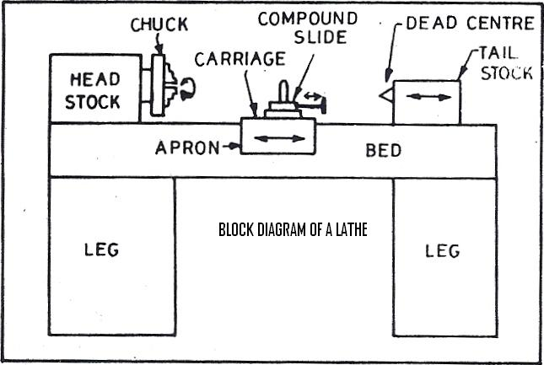

Slide 32
MAIN PARTS OF A LATHE:-1.Bed 2.Head stock 3.Tail stock 4.Carriage 5.Feed Mechanism 6.Legs.
Bed: - The bed of the lathe is the base on which different fixed and operating parts of the lathe are mounted. It provides inverted guide ways for well guided and controlled movement of the operating parts (Carriage) . It withstands various forces exerted on the cutting tool during operation .Bed is made of cast iron alloyed with nickel and aluminum.
Head Stock: - Head stock is housing for the driving pulleys and back gears. The head stock is secured at the left end of the lathe bed. It provides mechanism for work rotation at multiple speeds. It contains a hollow spindles and mechanism for driving and altering the spindle speed.
Tail Stock:-The tail stock is located on the ways at the right end of the bed. It has two main uses: - (1) It supports the other end of the work (2) It holds tool for performing operations such as drilling, reaming, tapping etc.

Slide 33
Saddle: It is the part of carriage which slides along the bed ways and supports the cross slide, compound rest and tool post.
Cross Slide: It is mounted on the saddle and moves in a direction normal to the axis of main spindle. It may be operated by hand; cross feed may be given by power feed through apron mechanism.

Slide 34
Compound Rest: It is mounted on the cross slide and carries a graduated circle base. The circle is graduated on the cross slide in degrees and compound rest may swivel to any angle on horizontal plane on the circular base. The upper part of the compound rest called compound slide can be moved by a feed screw.
Tool Post: It is the top most part of the carriage and it is used for holding the tool.
Apron: It is the hanging part in front of the carriage. It serves as housing for a no. of gear trains through which power feed can be given to the carriage and cross slide.
Legs: They are the supports which carry the entire load of the machine over them.
Centering: The centering is the process of making the longitudinal axis of job coinciding with the axis of chuck.

Slide 35
LATHE OPERATIONS:
Facing: In this operation feeding of the tool is perpendicular to the axis of rotation of the job. By this operation ends of a job is machined to produce a flat surface perpendicular to the axis.
Turning: Turning is the operation of removing excess material from the work piece to produce a cone shaped or cylindrical surface. Various turnings are as follows:
Straight Turning: In this operation the job is rotated about the lathe axis and the tool is fed parallel to the lathe axis. The straight turning produces a cylindrical by removing excess metal from the work piece.
Taper Turning: Taper turning means to produce a conical surface on the job. In this operation job rotates about the lathe axis and the tool is fed at an angle to the lathe axis.
Chamfering: It is the operation of beveling the extreme end of work piece. This is done to remove the burrs to have a better look, to pass the nut freely on the threaded work piece.
Thread Cutting: It is the most important operation performed on a lathe. The principle of thread cutting is to produce a helical groove on job surface by feeding the tool longitudinally when the job is rotated by a chuck.
The longitudinal feed should be equal to the pitch of the thread to be cut per revolution of the work piece.

Slide 36
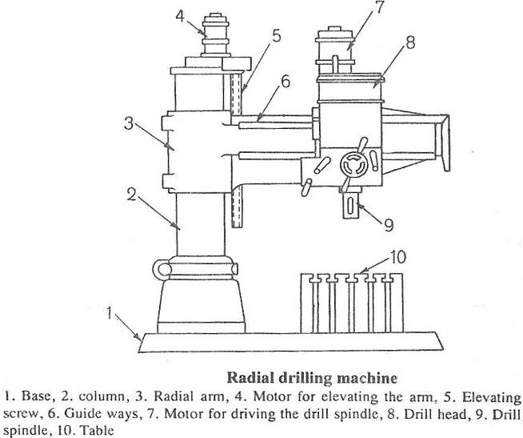
DRILLING MACHINE

Slide 37
BORING MACHINE
Boring machine is used to bore holes in large and heavy parts, which are practically impossible to hold and rotate in an engine lathe or a drilling machine. These parts are – engine frames, steam engine cylinders, machine housing etc.

Slide 38
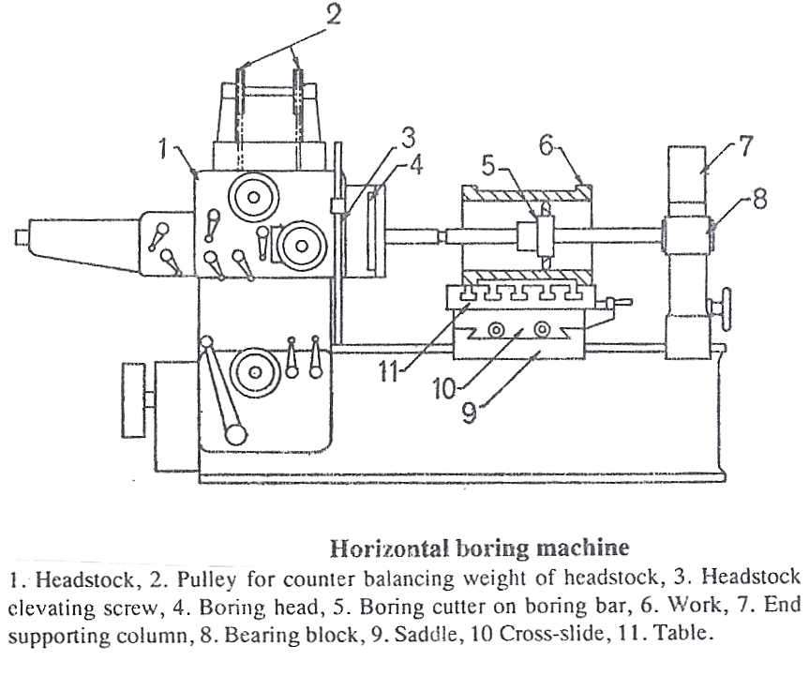
LAYOUT OF BORING MACHINE

Slide 39
SHAPER
WORKING PRINCIPLE:-The job is rigidly held in a vice or clamp directly on the machine table. The tool is held in the tool post mounted on the ram of the machine. This ram reciprocates to and fro. In doing so the tool cuts materials in the forward stroke. Return stroke is called idle stroke because no material cutting takes place in that stroke. The job is given an indexed feed in a direction normal to the line of action of cutting tool.
The time spent in return stroke is obviously a waste. We cannot make this time equal to zero, but it can be reduced. A mechanism called Whitworth Quick Return Mechanism is fitted in the shaper to reduce the time wastage during return (idle) stroke.

Slide 40
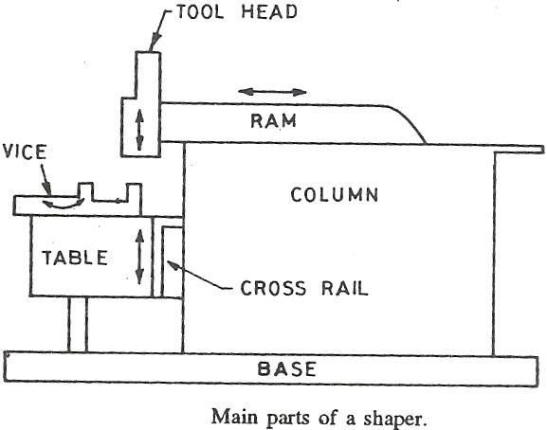
LAYOUT OF SHAPER

Slide 41
THREADS
The helical groove cut on an internal or external cylindrical surface is called thread. The thread on internal cylindrical surface is called internal thread and that on external cylindrical surface is called external thread. According to movement, threads are of two types: -
1. Right hand threads
2. Left hand threads.

Slide 42
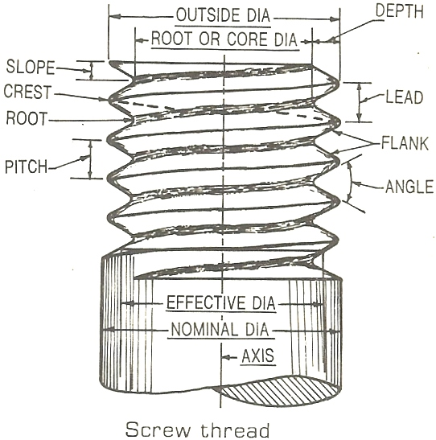

Slide 43
QUALITY CONTROLS
INTRODUCTION
The basic purpose of manufacturing is to produce engineering materials and parts to specified shape, size and finish. The specifications for the shape, sizes and finishes are furnished to the shop by part drawings or manufacturing drawings. These specifications are often called quality characteristics.

Slide 44
INSPECTION AND QUALITY CONTROL
Inspection:-Inspection is the method of measuring and/or checking the quality of product in terms of specified standard. There are three basic areas of inspection: - (1) Receiving inspection, (2) In process inspection and (3) Final inspection.
Quality Control: - The word “quality” as used in manufacturing implies “the best for the money in vested” and does not necessarily mean the “best”. A component is said to be of good quality if it works well in a particular situation for which it is meant while in other situation it may not work well and it is said to be bad quality. The word “control” implies regulation and regulation implies observation and manipulation. It suggests when to inspect and how much to inspect.
Inspection is considered to be tool of quality control. It checks the products while quality control attempts to bring the variable factors under control.

Slide 45
THE ISO 9000
ISO 9000 is a family of international standards for quality management and assurance. ISO 9001, ISO 9002, and ISO 9003 detail the requirements, which must be met. ISO 9000 and ISO 9004 are guidelines. Listed below are the models that make up the ISO 9000 family of standards.
ISO9001 Quality System is a model for quality assurance in design/development, production, installation, and servicing. ISO 9001 is made up of 20 sets of quality system requirements.
ISO 9002 Quality System is a model for quality assurance in production and installation.
ISO 9003 Quality System is the model for quality assurance in final inspection and test.
ISO 9004-1 and the other parts of ISO 9004 are the standards of guidelines on the elements of quality management and a quality system.

